Slide 1
Progress on distributed data structures in R
Indrajit Roy (HP Labs), Michael Lawrence(Genentech)
useR! 2015, Denmark

Slide 2

What is a distributed system?
A distributed system is one in which the failure of a computer you didn't even know existed can render your own computer unusable.
Email on 28 May 1987
Email contd..
The current electrical problem in the machine room is not the culprit …
Leslie Lamport
Turing Award Winner (2012)
Notes:
http://research.microsoft.com/en-us/um/people/lamport/pubs/distributed-system.txt

Slide 3
Why use distributed systems?
Bigger data needs bigger hardware
But there are practical limits to the performance of a single machine
Thus, we distribute work to multiple machines, operating in parallel
But clusters are difficult to program and manage
As a result, high-level, managed distributed systems were created
Examples: Hadoop MapReduce, Spark, distributed databases

Slide 4
Challenges faced by R users
Interfaces to distributed systems are custom, low-level, and non-idiomatic
SparkR, distributedR, MapReduce
Parallel computing packages focus more on parallel iteration than distributed data-structures
parallel, foreach, BiocParallel, etc
Low level code can achieve higher performance, but at substantial cost
Can we create an API that makes life easier for R users?

Slide 5
Solution: distributed data-structures
Many applications reuse data
Multi-analysis on same data: load once, run many operations
Iterative algorithms: most machine learning + graph algorithms
Persistent references avoid data movement overhead
Load data at master->send to workers -> collect at master -> send to worker->repeat
Expressing analyses as high-level data manipulations is more natural than explicit iteration, which exposes underlying complexity
What if we build an API based on distributed data-structures?

Slide 6
Some backends provide distributed data-structures
But existing backend APIs are difficult to use
Spark = In-memory cluster computing, fault-tolerance via RDDs, 80+ operators!
Map, flatmap, mapPartitions, mapPartitionsWithIndex,…
Lacks common array, list, data.frame operations that R users expect
SparkR: Wrapper around Spark’s existing RDD operators. Still, difficult to use
“.. RDD API has a number of low level functions and we would like to expose a more light-weight API that is both friendly to R users and easy to maintain”— Open SparkR JIRA ticket

Slide 7
Our goal
An R package that provides
Distributed variants of core R data-structures: array, data.frame, list
Common parallel operators for distributed data-structures
Shared infrastructure for backend implementations (Spark, distributedR,..)
What we are not proposing: A new distributed infrastructure

Slide 8
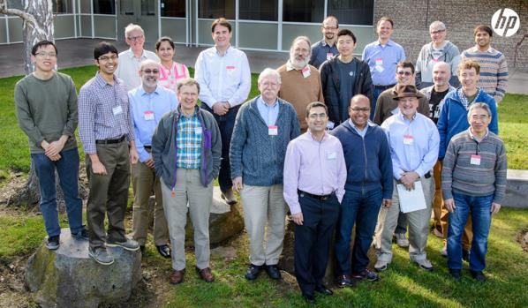
Behind the scenes
Workshop in Distributed Computing in R →
(January, 2015)

Slide 9
Package structure
dds := distributed data-structures
API package with data-structures + common operations
dds
useBackend(Spark)
useBackend(distributedR)
useBackend(XYZ)
Spark.dds
distributedR.dds
XYZ.dds
Third-party wrapper packages, delegating to existing backend interfaces

Slide 10
What does dds provide to clients?
Distributed versions of array, list, data.frame, with conventional APIs:
Accessors: parts, dim, names, [, …
Summaries: mean, median, head, tail, rowSums, aggregate, …
Filtering: subset
Sorting: sort
Combination: c, cbind, rbind, merge, …
Math and comparisons on arrays, transform on data.frames
Distributed iteration: dmapply, lapply, split, …
Distributed IO, e.g., dread(“data.csv”)
Enhanced ease of use, maintainability and portability due to standard API

Slide 11
What does dds provide to backends?
Implementation support
Default implementations minimize work necessary to construct a backend with essential functionality
Defaults may be overridden with direct, optimized implementations
Conventional abstraction enables backend to be lazy or eager, as appropriate

Slide 12
Deep dive: distributed list primitives
L <- dlist(..., nparts, psize)
Similar to list() convention
nparts and psize control partition count and size, respectively
P <- parts(L)
Return the set of partitions as a list of dlist objects
C <- collect(L)
Return the in-memory base R list representation of L
Generally only used after aggregation
E <- dmapply(FUN, X, Y, MoreArgs = list())
Apply FUN to elements of X and Y, returning a dlist

Slide 13
What do backends needs to provide?
At a minimum:
Constructor for darray, dlist, dframe backend objects
Each object needs three methods: parts, dmapply and collect
Defaults follow the form:
… collect(dmapply(FUN, parts(x))) …
Backend may override defaults as appropriate

Slide 14
Example, using distributedR backend:
> library(distributedR.dds)
> L <- dlist(1, 2, 3, 4)
> L2 <- dmapply(function(x) x + 1, L)
> collect(L2)
[[1]]
[1] 2
[[2]]
[1] 3
[[3]]
[1] 4
[[4]]
[1] 5

Slide 15
Example: distributed data loading
> L <- dlist(nparts = 4L)
> lengths(parts(L))
[1] 0 0 0 0
> L2 <- dmapply(function(x) read.csv(“data.csv”), parts(L))
The dds package will provide high-level utilities for distributed IO operations.

Slide 16
Current status
Basic structure of “dds” completed
Works with “distributedR” backend
Working with SparkR for Spark integration
Next steps
Default implementation of base R API
Complete integration with SparkR and distributedR in next few months
Looking forward to feedback from you all !

Slide 17
Thank you
Workshop attendees:
Brian Lewis, Dirk Eddelbuettel, Elliot Waingold, Gagan Bansal, George Ostrouchov, Joseph Rickert, Junji Nakano, Louis Bajuk-Yorgan, Luke Tierney, Mario Inchiosa, Martin Morgan, Michael Kane, Michael Sannella, Robert Gentleman, Ryan Hafen, Saptarshi Guha, Simon Urbanek
Implementation:
Edward Ma

