Slide 1


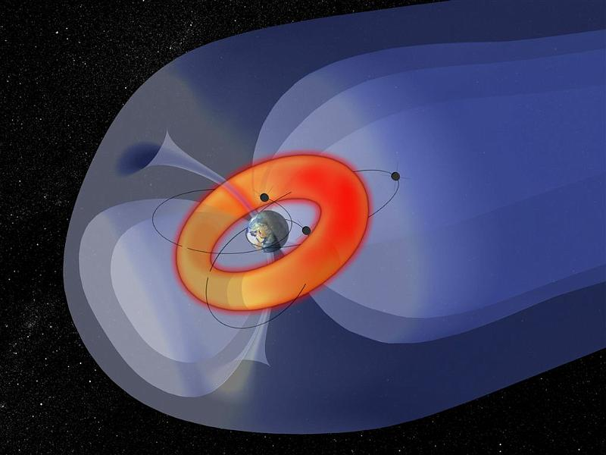
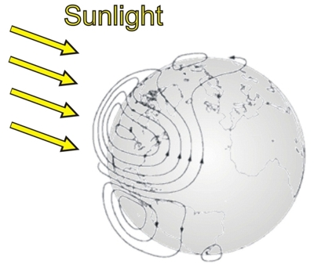
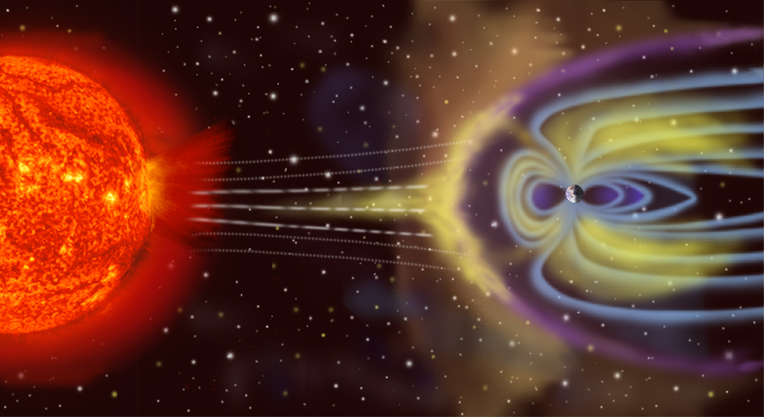
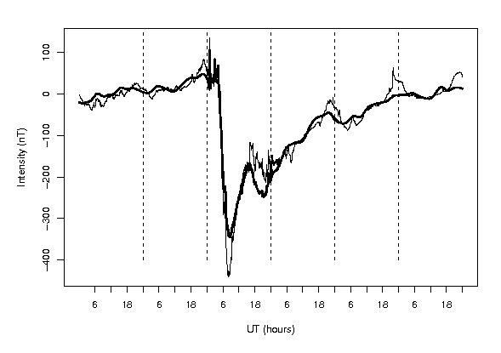
R package wfIMA: Wavelet-Functional Indexes of Magnetic Activity
Inga Maslova
Department of Mathematics and Statistics, American University, Washington, D.C.
Abstract
Storm activity index
Solar quiet variations
Phenomena
An R package for space physics applications, wfIMA is developed. It consists of several major functions that compute indices of the magnetic storm activity and estimate the Solar quiet daily variation. Both indexes are widely used in geophysical community. A novel approach based on wavelet and functional principal component analysis is used in order to develop an applied statistical software. This package implements the ideas introduced in Maslova, et. al. (2009) and Maslova et.al. (2010). It utilizes the functions of fda and waveslim packages. Magnetic storm activity indices and quiet daily Solar variations are computed automatically without any subjective human intervention using the most recent magnetometer data available. This allows to produce indexes in near-real time, which would be an attractive alternative to the current index. This package will be publicly available at Comprehensive R Archive Network (CRAN). It would be a very important tool for the geophysical community and would address the need of software that balances the parameter flexibility with reliable results.
Algorithm:
Perform Maximum Overlap Discrete Wavelet Transform using waveslim package, get the wavelet coefficients for the first 10 levels.
Threshold the wavelet coefficients for the first 7 levels.
Compute the Multi Resolution Analysis (MRA) details (use step 2 results).
Remove daily variation from the sum of details at levels j = 8, 9, 10.
  Center all stations used in the study.
  Convert data into a functional 1-day object. Compute the first functional principal component.
  Replace the outlier scores aligned through all stations with median scores.
  Estimate the non-constant daily component.
Add all filtered detail levels and the smooth.
Make latitude adjustment.
Center the filtered data.
Find the mean of all stations used.
Algorithm:
Subtract the storm index from each station records.
Add MRA details at levels j = 8, 9, 10.
Convert data from step 2 into a functional 1-day object.
Compute the first functional principal component.
Find the median score for each station. Find the absolute value of the scores centered around the median. Consider the largest 10% of such values to be outliers. Replace the outlier scores aligned through all stations with median scores.
Compute the Sq estimate for each station.
Figure 5. Ring Current (left panel); Ionospheric currents responsible for Sq variation during northern hemisphere summer (right panel)
Objective
Develop an easy-to-use software package that computes Magnetic Storm Index and Solar quiet daily variation from the raw magnetometer data.
-------------------------------------------------------------------------------------
SQ Solar quiet variation
-------------------------------------------------------------------------------------
Description
Estimates the daily non-constant Solar quiet variations
Usage
SQ (data, si.v)
Arguments
data matrix of the raw magnetometer records where the columns of the matrix correspond to different stations. Any number of mid-latitude stations can be used. It is recommended to use records from at least two stations
si.v vector of the index of storm activity in 1-minute resolution
Details
Returns Sq estimates for each station individually. First the storm index must be calculated using SAIndex, other storm indexes at 1-min resolution can be used
Value
Estimate of daily solar quiet variations
Summary
R package (a beta version) is available at http://wami.usu.edu/
Package contains two main functions that
  Compute the storm activity index associated with the ring current.
  Compute the estimate of the Sq variation;
Coming soon to the Comprehensive R Archive Network http://www.r-project.org/
Background
Figure 1. Coronal Mass Ejections
-------------------------------------------------------------------------------------
SAIndex Index of storm activity
-------------------------------------------------------------------------------------
Description
Computes the index of the magnetic storm activity
Usage
SAIndex (data, coord)
Arguments
data matrix of the raw ground-based magnetometer records (Horizontal component) at 1 min resolution. Columns of the matrix correspond to records from different stations. Any number of roughly equispaced equatorial stations can be used
coord matrix of the coordinates of the stations used. Each column corresponds to the station, the first row must contain the latitude and the second row − longitude
Details
Returns the Global index of the magnetic storm activity
Value
Global storm index estimate
References
Ring Current − an electric current of charged particles trapped in the planet’s magnetosphere (Figure 5 left panel).
Index of Storm Activity − is an index associated with the intensification of the Ring Current.
Jach, A., Kokoszka, P., Sojka, J., and Zhu, L. (2006), Wavelet - based index of magnetic storm activity, Journal of Geophysical Research ,111.
Maslova, I., Kokoszka, P., Sojka, J., and Zhu, L. (2009), Removal of nonconstant daily variation by means of wavelet and functional data analysis, Journal of Geophysical Research, 114, A03202, doi: 10.1029/2008JA013685.
Maslova, I., Kokoszka, P., Sojka, J., and Zhu, L. (2010), Estimation of SQ variation by means of multiresolution and principal component analyses, Journal of Atmospheric and Solar-Terrestrial Physics, 72, 625 - 632.
Figure 2. Magnetometer records from four equatorial stations: San Juan, Honolulu, Kakioka, Hermanus during March – April, 2001.
Figure 4. H-component of the magnetogram recorded at Alibag March 14 – March 17 (top panel) and March 29 – April 1, 2001 (bottom panel). Raw magnetometer data (thin red line), Sq daily variation computed using SQ function (thick line).
Figure 3. H-component of the magnetogram recorded at Honolulu March 29 - April 3, one out of 4 inputs (thin line), global storm index computed using SAIndex function (thick line). The dashed lines separate UT days.
Acknowledgements
Some of the code was provided by Agnieszka Jach Universidad Carlos III de Madrid.
Data provided by the global network of observatories – INTERMAGNET.
Used packages: waveslim by Brandon Whitcher, and fda by J.O. Ramsay, Hadley, Wickham, Spencer Graves, Giles Hooker
Figure 1: Image credit: NASA/ Steele Hill
Figure 5 left panel: Image credit: ISARS/NOA/ Ioannis A. Daglis
Contact information
For further information please contact Inga Maslova (Maslova@american.edu).
This poster is available upon request.

