Slide 1
Teaching Survey Sampling Theory using R
Michael D. Larsen
George Washington University
UseR 2010 poster session, 7/21/10

Slide 2
Uses of R in the course
Data analysis; exploring data
Programming complex formulas
Simulation of properties of estimators
Make estimation easier so one can think about concepts

Slide 3
Exploring data
Examine means, sizes of clusters: more variability increases variance
Examine means, sizes across strata: more variability decreases variance
Examine skewness of variables: extreme skewness in population can lead to unrealistic sample-based estimates

Slide 4
Exploring Data: Tools
Side-by-side boxplots
  boxplot(split(senic$nurses, senic[,c("region","medical")]),
  xlab="four regions in U.S.; two hospital types",
  ylab="# nurses", main="113 hospitals in U.S.")
Histograms
Numerical summaries
Correlations; regression
sapply for lists created using ‘split’ command

Slide 5
Comparing two factors for stratification potential

Slide 6
Programming complex formulas
Checks understanding of formulas
Helps memorization of formulas
Next page: two-stage cluster sample estimator for total and variance of total

Slide 7
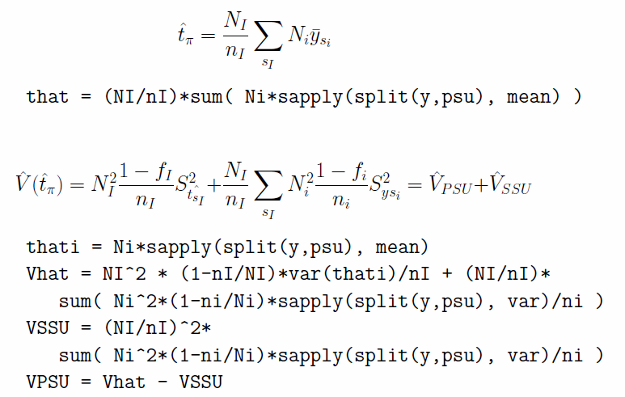

Slide 8
Simulation
Using functions, one can contrast complex estimation methods in terms of bias, variance and MSE
Simulating 1,000 samples and plotting results gives different impression than mathematical result; Impact of skewness and outliers is more transparent

Slide 9
Ease of use
Make estimation easier so one can think about concepts; Possible to focus on contrasts and more variables
Students can do more ambitious projects and handle ‘real’ data

Slide 10
Ease of use example
For a given budget and population, what is the advantage of more clusters with smaller sample sizes versus fewer clusters with bigger sample sizes?
  Compute variances under three scenarios.
  Take 10,000 samples under three different scenarios and compute variance of estimates.
  Apply to three different variables. Write a summary.

Slide 11
Suggestions, part 1
Consistent syntax across survey designs
Ease of use: be clear on what time of variables are needed – factor, numeric, etc.
More examples with more numbers that can be replicated

Slide 12
Suggestions, part 2
Recover formula – not only R syntax but also an estimation formula – when run command
More details in context when errors occur:
  Your sample sizes for clusters (ni) exceed your population sizes for clusters (Ni).
  Only one primary sampling unit (defined by psu) is available for some clusters
Include writing projects based on data analysis

