Slide 1
Text Access and Analytics
The R User Conference 2010
July 20-23
National Institute of Standards and Technology (NIST),
Gaithersburg, Maryland, USA
Bill Ladd, Ph.D.
Recorded Future

Slide 2


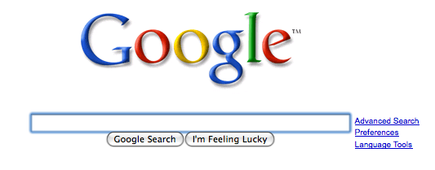

Internet currently organized by Keywords
Merck
Merck, Vioxx
Merck, Pfizer
Merck, Next week
Karzai
Kabul, 2010
Afghanistan, 2010
Attack, Iraq
Keyword based Index
Obama
Merck
Resignation
Pfizer
Osama
Iraq
al-Malaki
Bomb
July
Paris
2010
Merck
Paris
Volvo
Vioxx
Sunday
Merck
Karzai
Kabul
Next year
Afghanistan
Karzai
2010
Pfizer
Paris Hilton

Slide 3









Organizing the Internet Temporally
Kabul Next Week
Travel Kabul Next Month
Meeting Kabul Next Month
Materials Movement Kabul
Trend of IEDs in Kabul
What precedes IEDs in Kabul
Anomalies in Afg. cities
Statements and Actions
Now!
Temporal Event Index
Momentum
Sentiment
Real Time Web

Slide 4
Text analytics
Text Harvesting
Web, Databases, Filings
Production environment for acquiring and serving content
Linguistic Processing
Entities, Events, Time, Sentiment, Momentum
Recorded Future Data Store
Web Site
Online Analytics
Web Services
External Analytics

Slide 5
Text analytics
Text Harvesting
Web, Databases, Filings
Obtain unstructured text from 5000+
sources
Mainstream media,
Blogs,
SEC filings,
etc

Slide 6
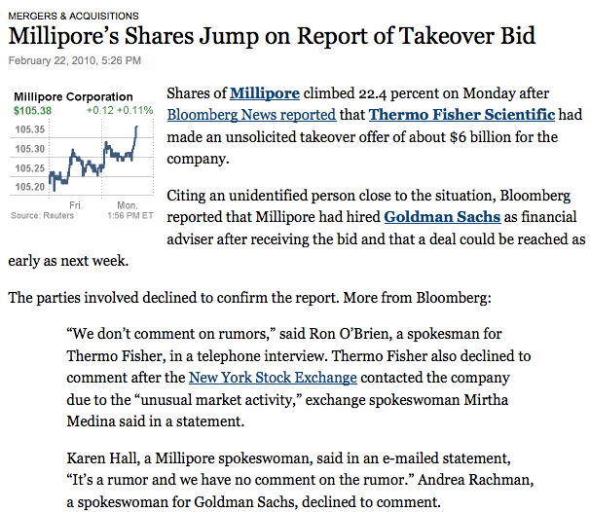
Text analytics
Text Harvesting
Web, Databases, Filings
Analyze and structure content
Define entities, events and times
Calculate additional metrics: sentiment, momentum
Linguistic Processing
Entities, Events, Time, Sentiment, Momentum
Millipore
Thermo Fisher
Goldman
NYSE
Entities
Bid
Acquisition
Share price increase
Hiring of advisor
Events
Feb 22
On Monday
Next week
Event times

Slide 7
Text analytics
Text Harvesting
Web, Databases, Filings
Store newly structured content
(Amazon Cloud)
Linguistic Processing
Entities, Events, Time, Sentiment, Momentum
Recorded Future Data Store

Slide 8
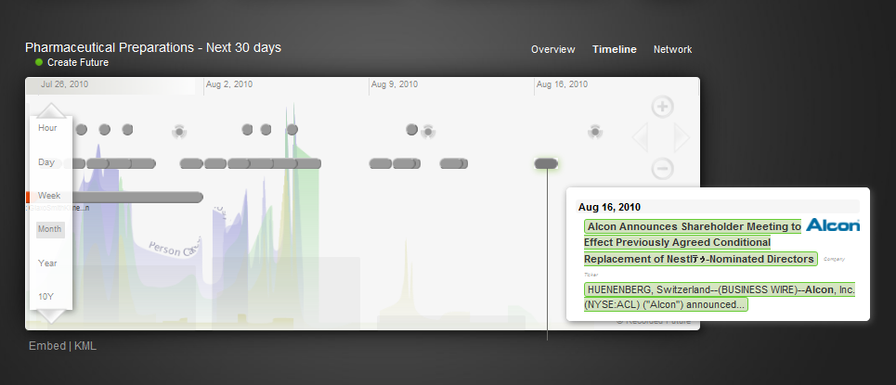
Text analytics
Text Harvesting
Web, Databases, Filings
Deliver temporal content from
Web Site
Linguistic Processing
Entities, Events, Time, Sentiment, Momentum
Recorded Future Data Store
Web Site
Online Analytics

Slide 9
Text analytics
Text Harvesting
Web, Databases, Filings
Web Services deliver data for External Analytic Applications
Linguistic Processing
Entities, Events, Time, Sentiment, Momentum
Recorded Future Data Store
Web Site
Online Analytics
Web Services
External Analytics

Slide 10
Web Service Interface
JSON Interface
Python
Web Services
External Analytics
R
JAVA

Slide 11
Web Service Interface
JSON Interface
Python
Web Site
Online Analytics
R
Spotfire
JAVA

Slide 12
Using the Web Service
Need to build a structured JSON String
Create and submit the associated URL
Retrieve the resulting object
{
"instance": {
"type": ["ProductRelease"],
"attributes": [{"type": "Company",
"entity": {"attributes": [{"name": "gics",
"string": "Information Technology"}]}}],
"document": {"published": {"min": "2010-01-01", "max": "2010-03-12"}},
"limit": 1
},
"output": {"fields": ["type", "time", "fragment", "momentum", "attributes", "document.title", "document.url", "document.published", "source.description"]}
}
http://api.recordedfuture.com/ws/rfq/instances?q=%7B%0A%20%22instance%22%3A%20%7B%0A%20%22type%22%3A%20%22ProductRelease%22%2C%0A%20%20%20%22attributes%22%3A%20%7B%0A%20%22type%22%3A%20%22Company%22%2C%0A%20%20%20%22entity%22%3A%20%7B%0A%20%22attributes%22%3A%20%7B%0A%20%22name%22%3A%20%22gics%22%2C%0A%20%20%20%22string%22%3A%20%22Information%20Technology%22%20%0A%7D%20%0A%7D%20%0A%7D%2C%0A%20%20%20%22document%22%3A%20%7B%0A%20%22published%22%3A%20%7B%0A%20%22min%22%3A%20%222010%2D01%2D01%22%2C%0A%20%20%20%22max%22%3A%20%222010%2D03%2D12%22%20%0A%7D%20%0A%7D%2C%0A%20%20%20%22limit%22%3A%201%20%0A%7D%2C%0A%20%20%20%22output%22%3A%20%7B%0A%20%22fields%22%3A%20%5B%20%22type%22%2C%20%22time%22%2C%20%22fragment%22%2C%20%22momentum%22%2C%20%22attributes%22%2C%20%22document%2Etitle%22%2C%20%22document%2Eurl%22%2C%20%22document%2Epublished%22%2C%20%22source%2Edescription%22%20%5D%20%0A%7D%2C%0A%20%20%20%22token%22%3A%20%%22%20%0A%7D&compress=0

Slide 13
Sample Query
{
"instance": {
"type": ["ProductRelease"],
"attributes": [{"type": "Company",
"entity": {"attributes": [{"name": "gics",
"string": "Information Technology"}]}}],
"document": {"published": {"min": "2010-01-01", "max": "2010-03-12"}},
"limit": 1
},
"output": {"fields": ["type", "time", "fragment", "momentum", "attributes", "document.title", "document.url", "document.published", "source.description"]}
}

Slide 14
{
"status": "SUCCESS",
"instances": [
{
"fragment": "Symantec Corp. (Nasdaq: SYMC) today announced Symantec Data Insight, a new technology that enables organisations to improve data governance through insights into the ownership and usage of unstructured data , including files such as documents, spreadsheets ...",
"stop": "2010-03-03T23:59:59.000Z",
"start": "2010-03-03T00:00:00.000Z",
"attributes": {
"status": "announced",
"product": 117180333,
"product_type": "Other",
"company": 33312357,
"date": "2010-03-03",
"date_string": "today"
},
"document": {
"url": "http://www.scoop.co.nz/stories/BU1003/S00094.htm",
"source": {
"description": "Scoop NZ - Business"
},
"published": "2010-03-03T00:52:00.000Z",
"title": "Symantec Answers \u0093Whose Data Is It Anyway?\u0094"
},
"type": "ProductRelease",
"momentum": 0.0
},
],
"errors": [],
"entities
"33312357": {
"type": "Company",
"name": "Symantec",
"momentum": 0.015923216777303299
},
"117180333": {
"type": "Product",
"name": "Symantec Data Insight",
"momentum": 8.3941912196759793e-06
}
}
}
The JSON results object is a structured, hierarchical text string

Slide 15
Using the Web Service with R
RJSONIO is an R package that converts between JSON strings and R list objects
RCurl is an R package that posts URLs (in this case containing the JSON query) and retrieves the results
Additional R routines can be written as necessary to define and work with the R objects required and returned using the RJSONIO commands

Slide 16
JSON Query as R Object
>print(Rquery)
$instance
$instance$type
[1] "ProductRelease"
$instance$attributes
$instance$attributes[[1]]
$instance$attributes[[1]]$type
[1] "Company"
$instance$attributes[[1]]$entity
$instance$attributes[[1]]$entity$attributes
$instance$attributes[[1]]$entity$attributes[[1]]
$instance$attributes[[1]]$entity$attributes[[1]]$name
[1] "gics"
$instance$attributes[[1]]$entity$attributes[[1]]$string
[1] "Information Technology"
$instance$document
$instance$document$published
$instance$document$published$min
[1] "2010-01-01"
$instance$document$published$max
[1] "2010-03-12"
$instance$limit
[1] 1
$output
$output$fields
[1]"type" "time" "fragment" "momentum" "attributes" "document.title" "document.url" "document.published“ "source.description"
Standard R list object with two top level elements: instance and output

Slide 17
Converting R Object to JSON Query
> json.Query<-toJSON(Rquery)
> cat(json.Query)
{
"instance": {
"type": ["ProductRelease"],
"attributes": [{"type": "Company",
"entity": {"attributes": [{"name": "gics",
"string": "Information Technology"}]}}],
"document": {
"published": {"min": "2010-01-01", "max": "2010-03-12"}
},
"limit": 1
},
"output": {
"fields": ["type", "time", "fragment", "momentum", "attributes", "document.title", "document.url", "document.published", "source.description"]
}
}
JSON String created with a simple function applied to the R list object

Slide 18
Retrieving Query Results and Converting to R list Object
> opts = curlOptions(header = FALSE
> url<-paste("http://api.recordedfuture.com/ws/rfq/instances?q=",
RCurl::curlEscape(jsonQuery),"&compress=1",sep="")
> zippedJsonResult<-getBinaryURL(url, .opts = opts)
> jsonResult<-rawToChar(memDecompress(zippedJsonResult,type="gzip")
> RqueryResult<-fromJSON(jsonResult)
Use RCurl routines to form URL and retrieve data (unzipping)
Use fromJSON from the RJSONIO package to create the resulting R object

Slide 19
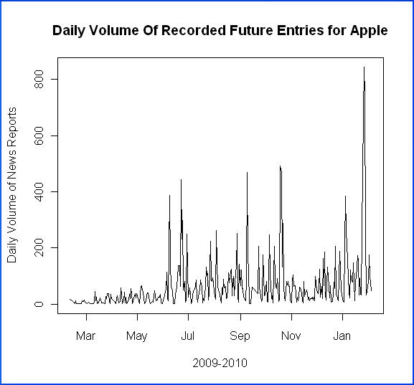
Inspect News Intensity over Time
Observe patterns and trends
weekends
holidays
harvesting volume
iPad

Slide 20
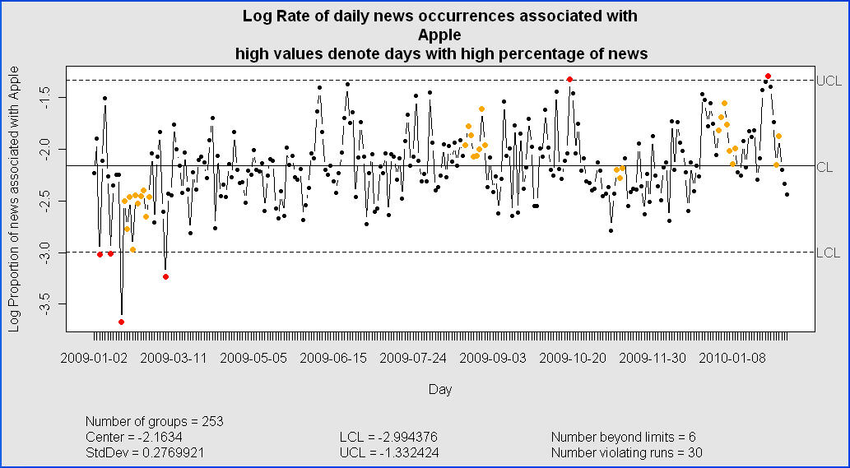
“Control” Charts
Normalize and observe atypical days and trends
Use qcc package

Slide 21
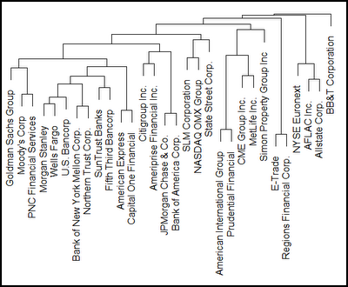
Data exploration
Cluster financial companies based on news intensity over time

Slide 22
Modeling
Does news momentum contain predictive information for market volume
Call:
lm(formula = Dollarvol.1 ~ 0 + lDollarvol.1 + smaDvol.Dollarvol.1 +
smaxlMo, data = seriesdf)
Residuals:
Min 1Q Median 3Q Max
-5.039e+09 -2.215e+07 -2.284e+06 1.813e+07 1.597e+10
Coefficients:
Estimate Std. Error t value Pr(>|t|)
lDollarvol.1 0.513193 0.003237 158.54 < 2e-16 ***
smaDvol.Dollarvol.1 0.471645 0.003817 123.56 < 2e-16 ***
smaxlMo 0.077162 0.015683 4.92 8.67e-07 ***
---
Signif. codes: 0 ‘***’ 0.001 ‘**’ 0.01 ‘*’ 0.05 ‘.’ 0.1 ‘ ’ 1
Residual standard error: 170900000 on 72109 degrees of freedom
Multiple R-squared: 0.8539, Adjusted R-squared: 0.8539
F-statistic: 1.405e+05 on 3 and 72109 DF, p-value: < 2.2e-16

Slide 23
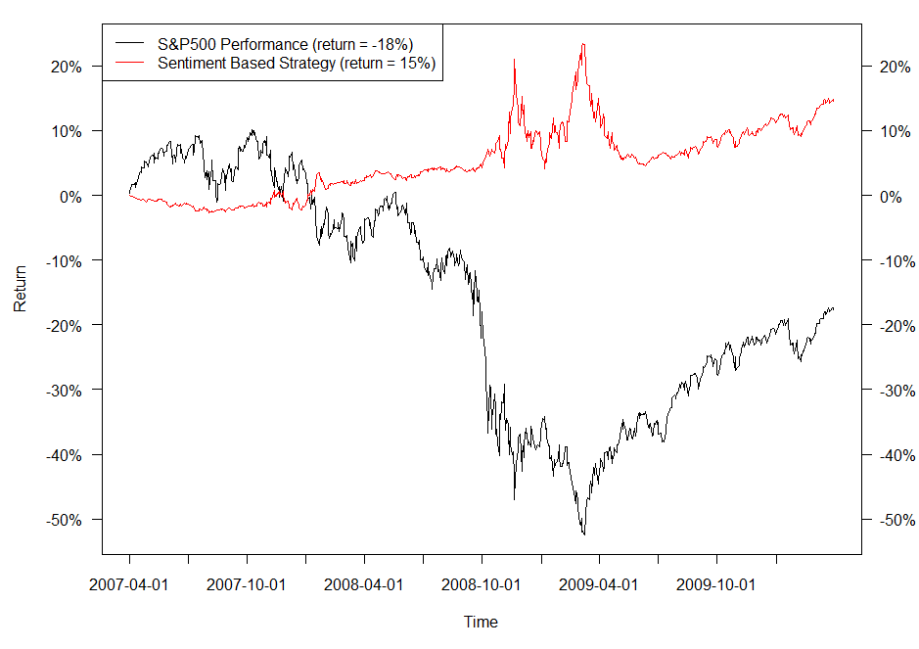
Trading Strategy
Use text sentiment signal to define a trading strategy
Use fImport package to incorporate market data
Use Performance Analytics package to calculate returns

Slide 24
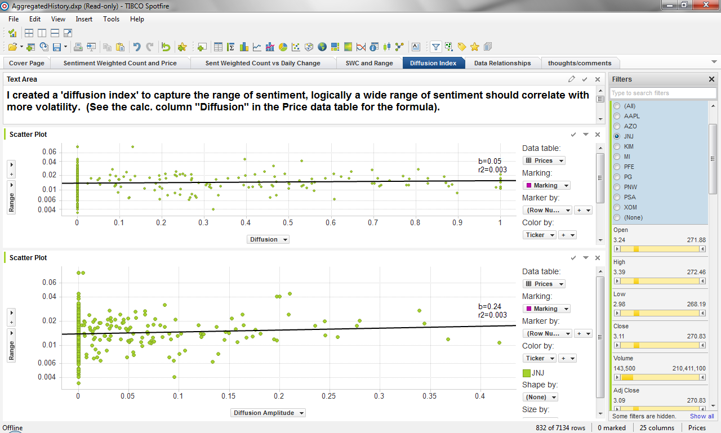
Results presentation - Spotfire

Slide 25
Comments
The Web is a data generator, not just an “Information Highway”
Define analytic application strategy
  Use the right tools for the right job
Packages are essential
  The whole is more than the sum of its parts

