Slide 1
Stochastic Modeling and Simulation in the Design of Multicenter Clinical Trials
Frank Mannino¹
Richard Heiberger²
Valerii Fedorov¹
¹Research Statistics Unit, GlaxoSmithKline
²Department of Statistics, Temple University

Slide 2
Outline
Motivation for using modeling & simulation in designing late-stage clinical trials
Simulation approach used at GSK
Example using RExcel interface
Conclusions

Slide 3
Issues in Multicenter Clinical Trials
Late stage clinical trials are costly and inefficient
Simplistic assumptions lead to underpowered trial
Variability not properly accounted for
Drug supply process can be very wasteful
Independent design decisions are made about interacting factors

Slide 4
Interacting Design Factors
Patient recruitment
How many centers, how long will we wait, etc.
Randomization
Statistical modeling
How many patients, best analysis model, etc
Patient dropouts
Drug supply
Notes:
Small subset of possible options, but other factors based on uncertain information

Slide 5
Use of Simulations
Emphasizing only a single design factor can sometimes permit analytic results
e.g., finding sample size
Dealing with multiple interacting factors (or abnormal design characteristics) cannot be handled analytically
Simulations allow us to handle interactions

Slide 6
R Package
Multicenter Simulation Toolkit (MSTpackage)
Developed within Research Statistics Unit at GSK
Has been used for approximately 15 different studies
Typical run of 10,000 simulations will take between a 1 and 6 hours, depending on complexity and number of scenarios being considered

Slide 7
Highlights: Recruitment & Randomization
Patients simulated according to Poisson process
Rates for each center sampled from a Gamma distribution
Randomization includes permuted block, biased coin, & minimization
Stratification by center, region, previous treatment, or other covariates

Slide 8
RExcel Interface
RExcel is an add-in that allows the full functionality of R to be accessed from Excel
Allows sharing of complex R-based programs with users who have no knowledge of R
Communication between the programs is hidden from the user

Slide 9
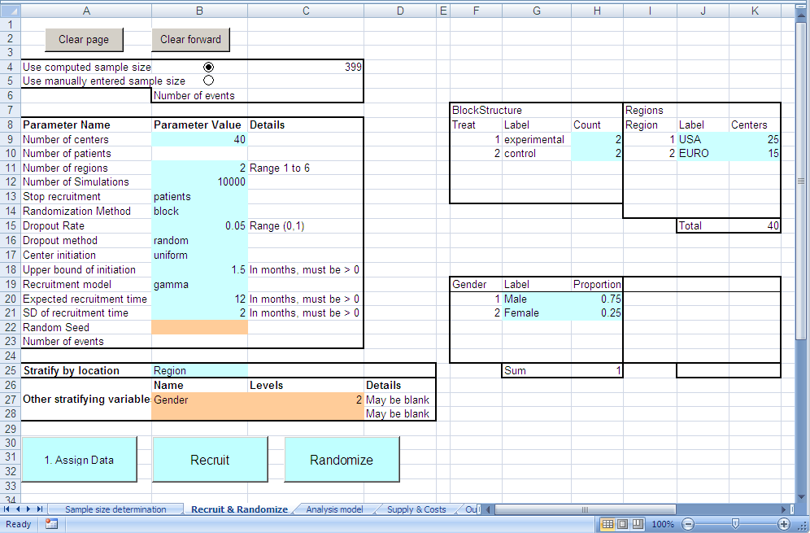
Toolkit interface

Slide 10
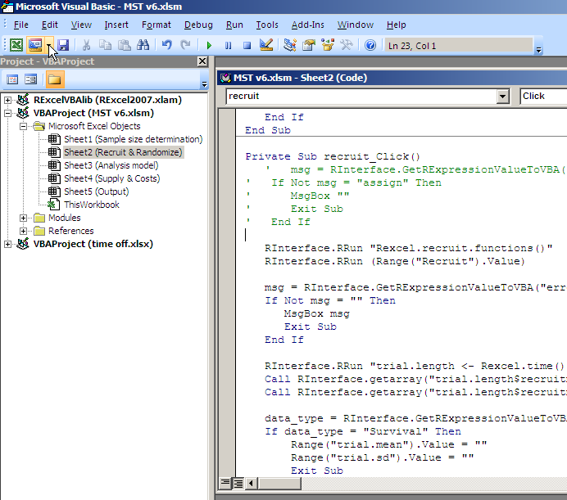
Interactions between R & Excel

Slide 11
Drug Supply
Once virtual patients are recruited and randomized, we can apply various drug supply strategies
e.g., when & how much drug to ship both to centers and regional depots
Allows us to chose a scenario that minimizes cost while also controlling for the number of patients without drug

Slide 12
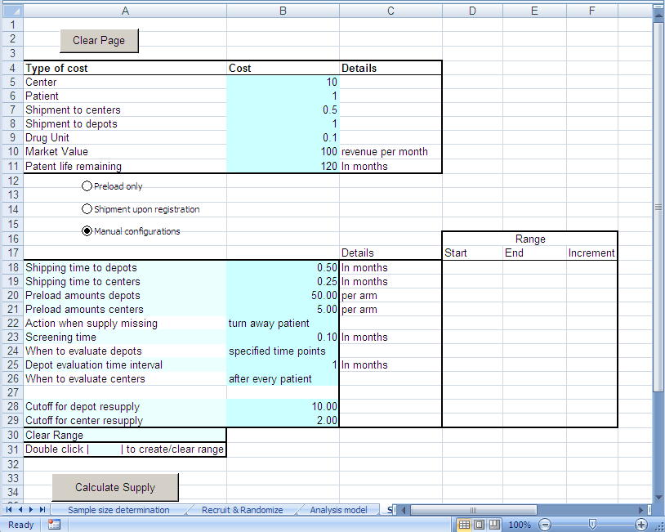
Drug Supply

Slide 13
Outputs of Interest
Statistical power
Length of trial
Cost of trial
Drug supply considerations
Probability of patients being without drug
Important to consider variability in these output values!

Slide 14
Length of Recruitment & Trial

Slide 15
Patient Loss as a Function of Overage
95% probability of 8 or less patients without drug
95% probability of 0 patients without drug
60% probability of 0 patients without drug
Overage = Percent excess drug supply

Slide 16
Decisions & Information Gained with MST Toolkit
Choice of randomization
Whether to stratify by center
Distribution of costs
Waiting times for recruitment and trial completion
Imbalances between treatment arms
More realistic estimate of power of study

Slide 17
Conclusions
Modeling & Monte Carlo simulation is the best way to understand the interactions between various design factors
All outcomes (power, costs, etc.) are distributions
Using better designs will lead to more statistically robust results and more cost efficient designs
The RExcel interface increases the impact of the R software within GSK

Slide 18
References
Anisimov, V. and Fedorov V., “Modeling, prediction and adaptive adjustment of recruitment in multicentre trials”, Stat in Med., 26: 4958–4975
Thomas Baier and Erich Neuwirth (2007), Excel :: COM :: R, Computational Statistics 22/1, pp. 91-108
R Development Core Team (2010). R: A language and environment for statistical computing. R Foundation for Statistical Computing, Vienna, Austria. ISBN 3-900051-07-0, URL http://www.R-project.org.

