Slide 1
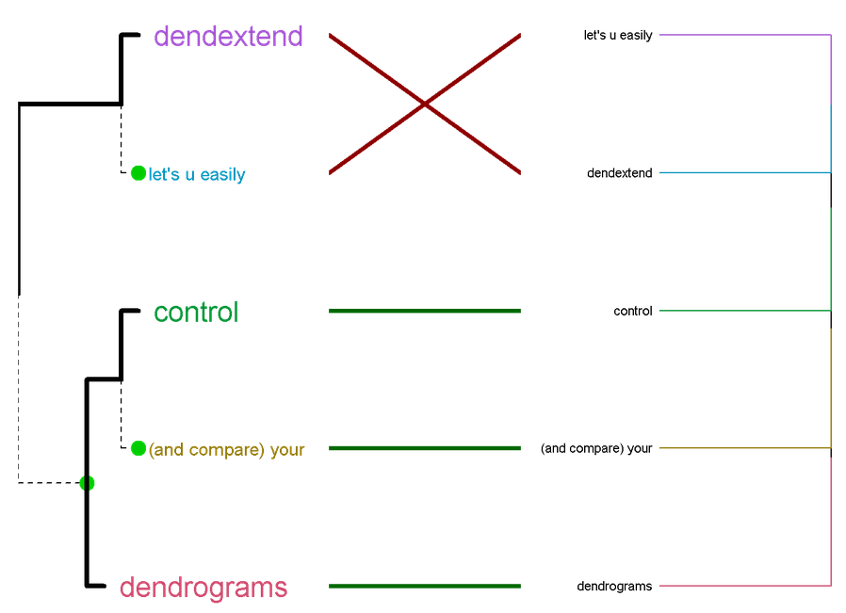
user!2015 - The dendextend package

Slide 2
Talk outline
Link to this presentation + dendextend
1 example
The most useful functions
Thanks!

Slide 3
Getting
this presentation
Go to: www.R-statistics.com
Or: just e-mail me:

Slide 4
Getting dendextend

Slide 5

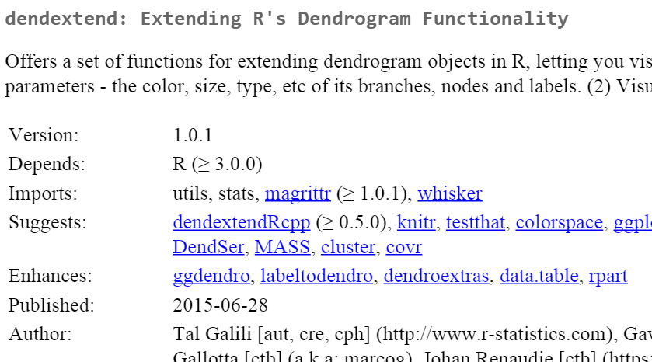

Slide 6
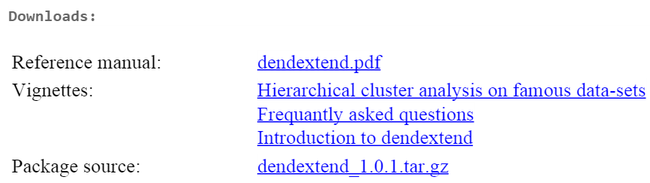
Further reading

Slide 7
Further reading
(1 example - no code)

Slide 8
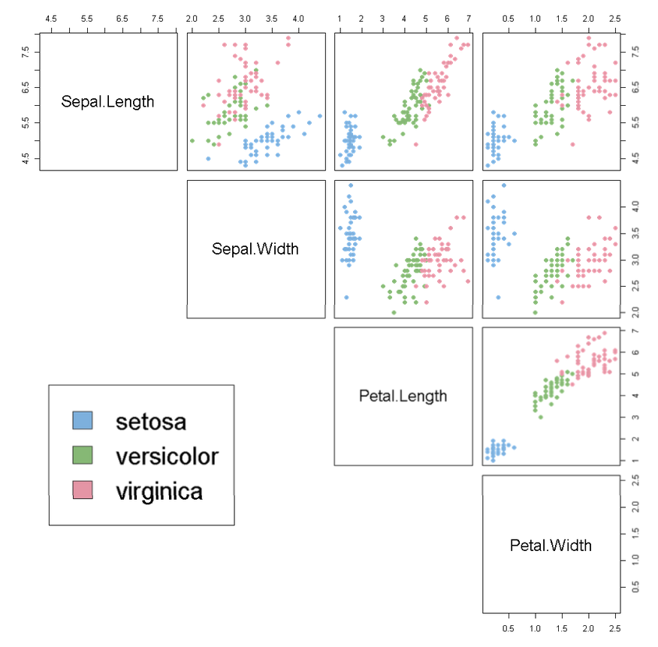
The Iris dataset

Slide 9
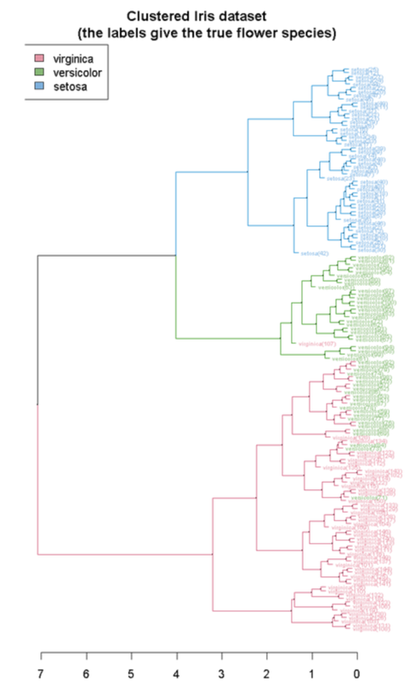
The Iris dataset

Slide 10
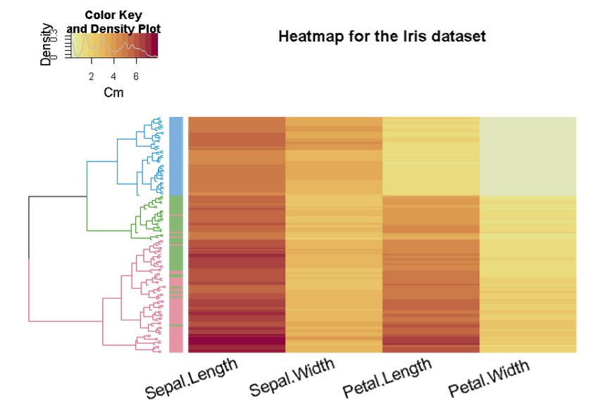
The Iris dataset
Using heatmap.2 from gplots

Slide 11
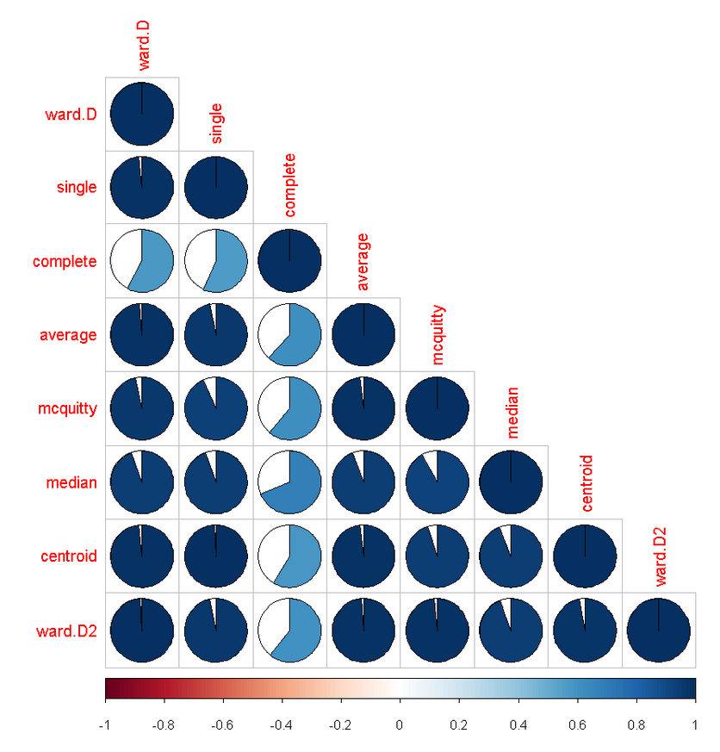
Why is “complete” different?
Comparing 8
Clustering algorithms on
The Iris dataset
Using dendlist,
cor.dendlist +
The corrplot package

Slide 12
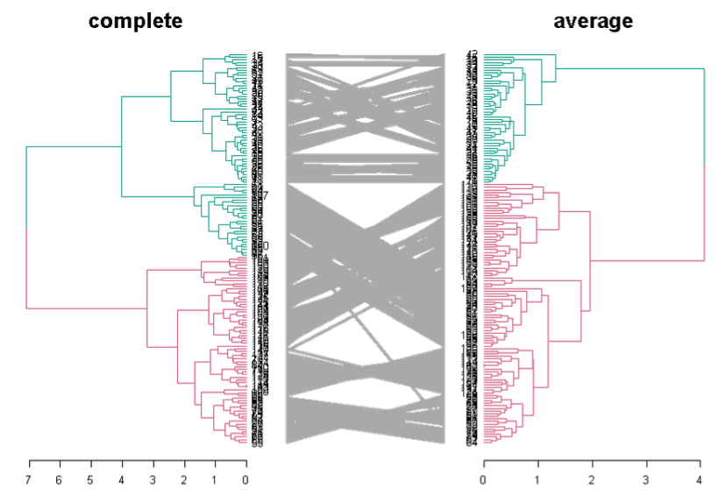
Why is “complete” different?

Slide 13
Back to
basics

Slide 14
Building a dendrogram

Slide 15
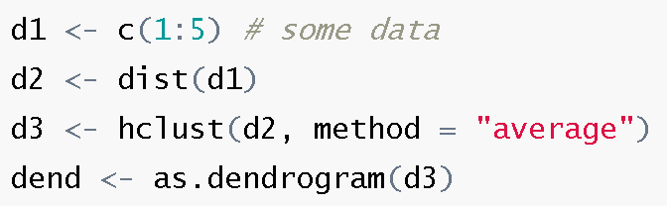
hclust -> dend

Slide 16
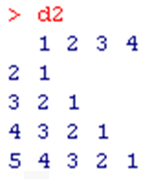
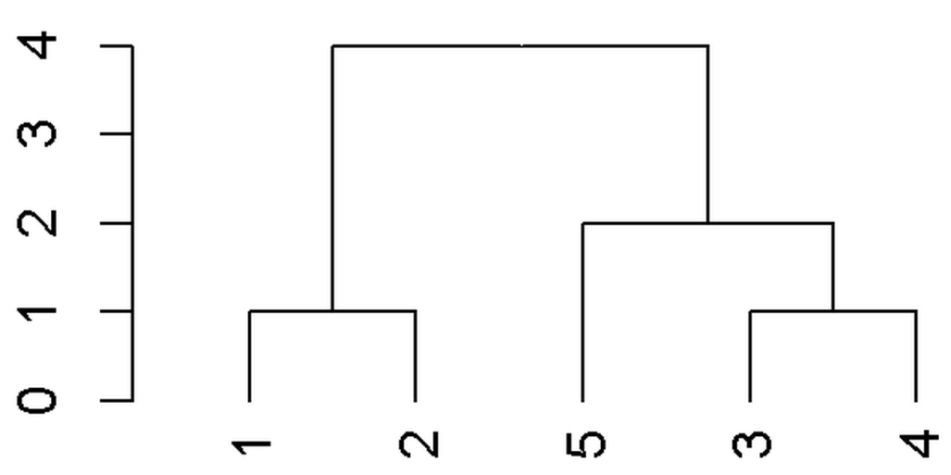
hclust -> dend

Slide 17
Useful functions
labels
labels_colors
cutree
color_branches
sort
tanglegram
set (!)

Slide 18
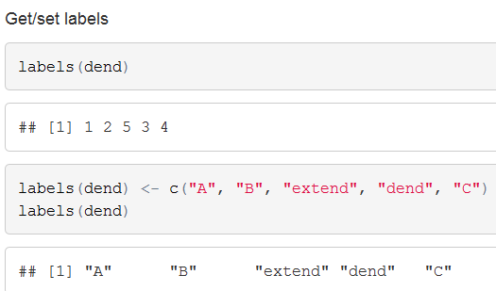

Slide 19
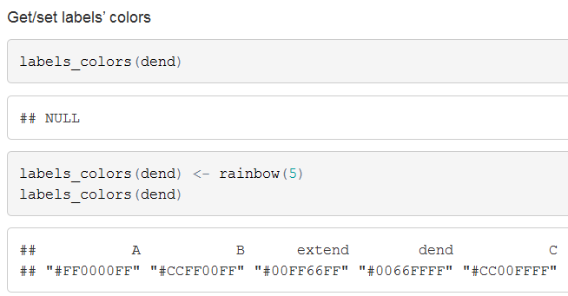

Slide 20
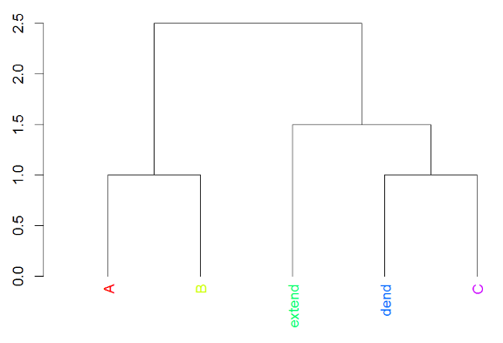

Slide 21
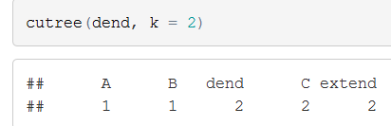

Slide 22


Slide 23
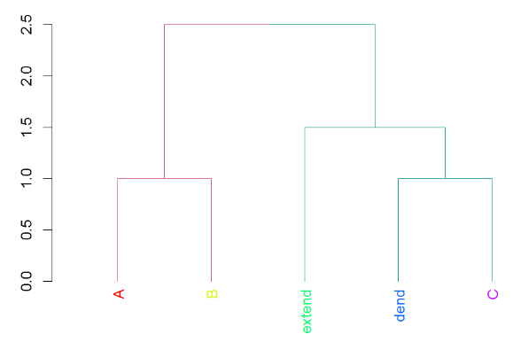

Slide 24

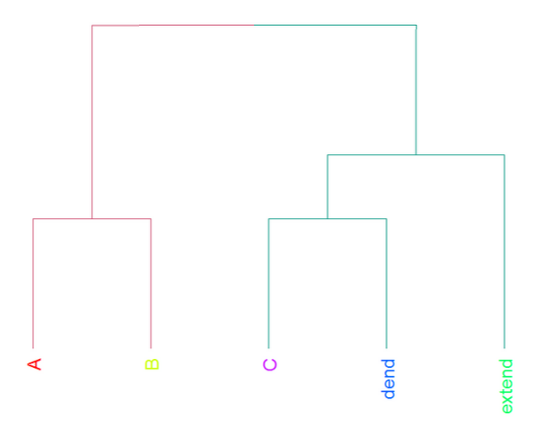

Slide 25
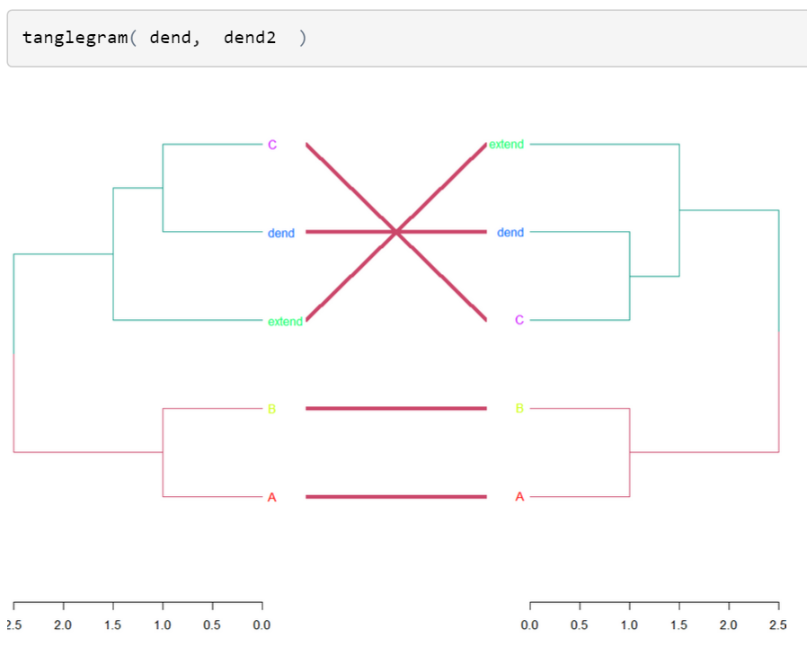

Slide 26
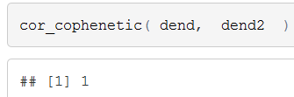

Slide 27
2 useful
connections

Slide 28

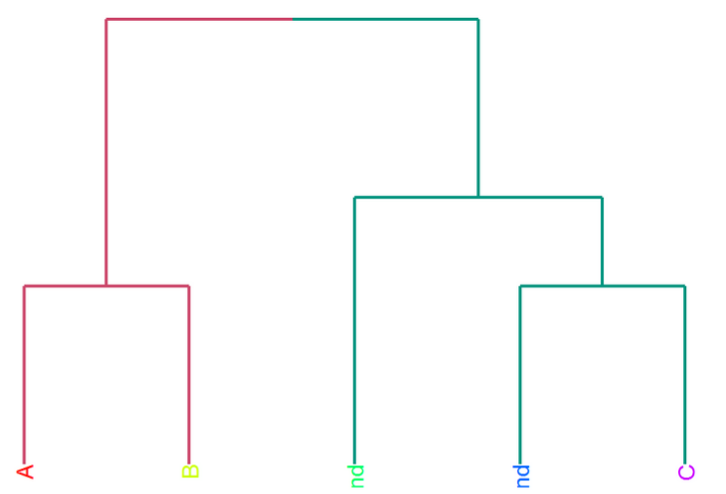

Slide 29
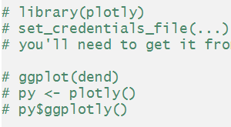

Slide 30
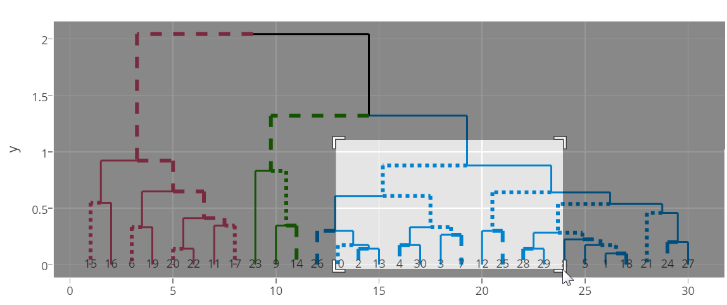
Send a dendrogram to plot.ly
https://plot.ly/~talgalili/6/y-vs-x/

Slide 31
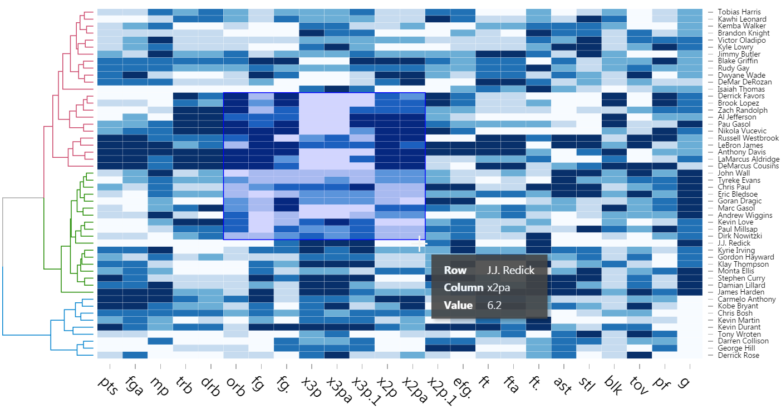
Send a dendrogram to d3heatmap
Joint work with Joe Cheng

Slide 32
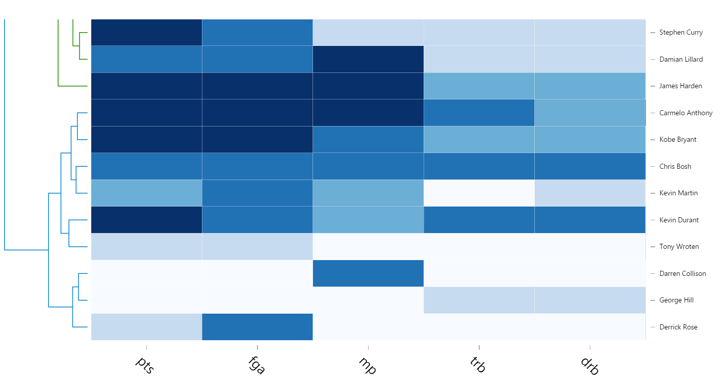
Send a dendrogram to d3heatmap
http://asbcllc.com/blog/2015/june/nba_14_15_top_50_heatmap/index.html

Slide 33
ONE more function

Slide 34
(but first…)
Using pipes
%>%

Slide 35

hclust -> dend

Slide 36
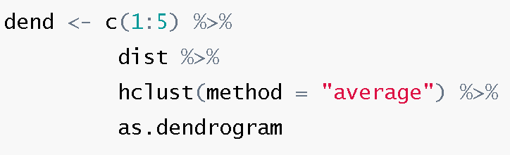
hclust + pipes (via magrittr)

Slide 37
Changing a dendrogram

Slide 38

The set function
set(dend, what, value)
One function
to rule them all!

Slide 39
The set function
set(dend, what, value)
dend a dendrogram
what the property to update
value new values to set in the tree

Slide 40
The set function
set(dend, what, value)
Type | “what"
Labels | labels, labels_to_character, labels_colors, labels_cex, labels_to_character
Leaves | leaves_pch, leaves_col, leaves_cex, hang_leaves
Nodes | nodes_pch, nodes_col, nodes_cex
Branches | branches_lty, branches_col, branches_lwd, branches_k_color, by_labels_branches_lty, by_labels_branches_col, by_labels_branches_lwd

Slide 41
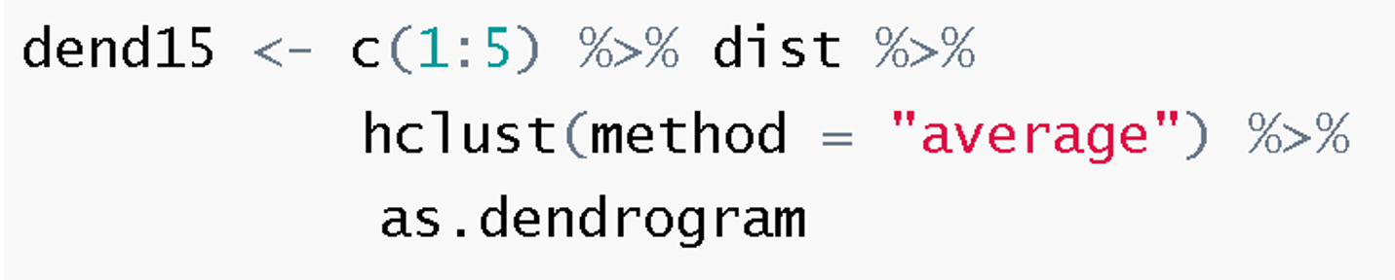
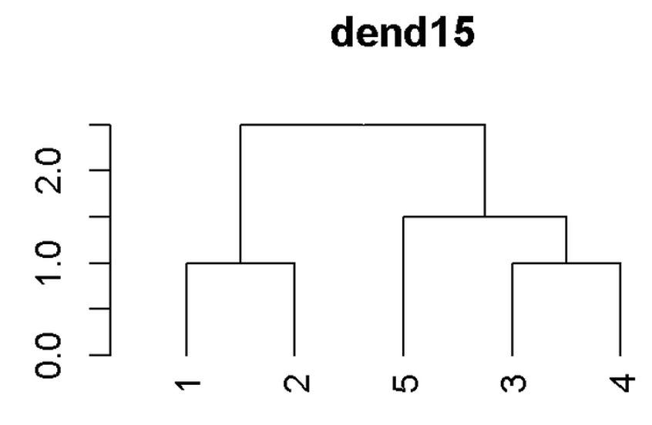
A dend exmaple

Slide 42
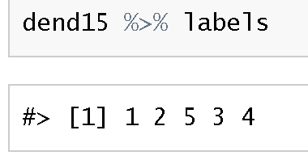
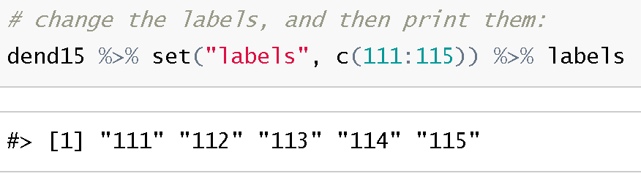
Modify labels

Slide 43
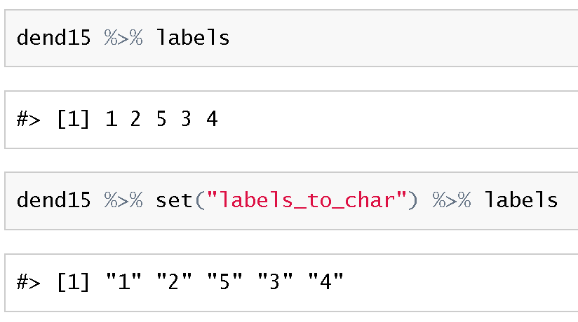

Slide 44
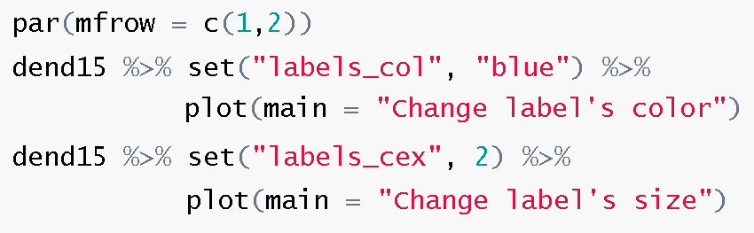
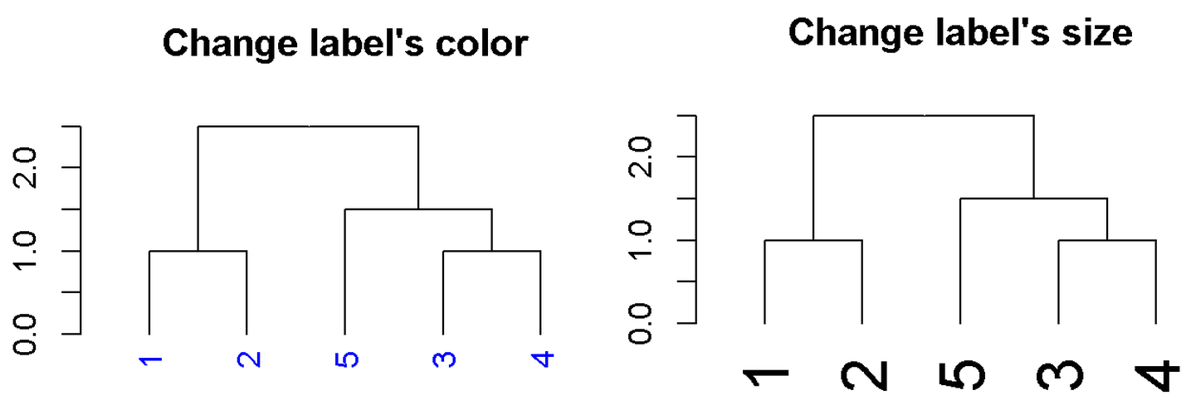

Slide 45
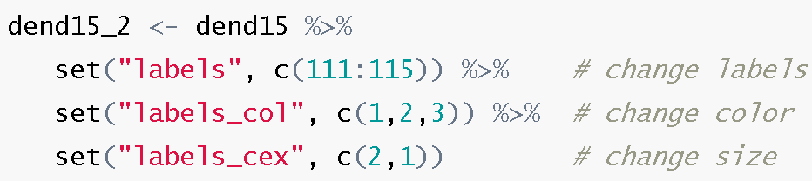
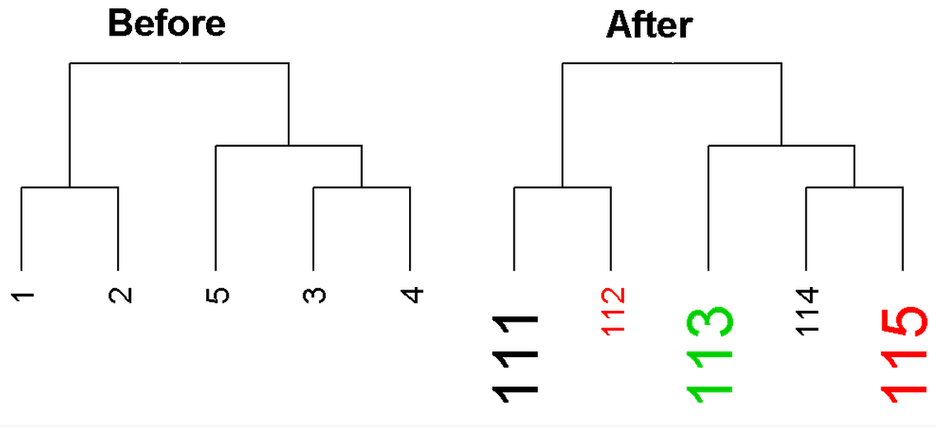

Slide 46
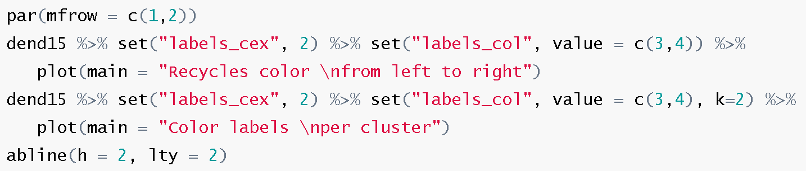
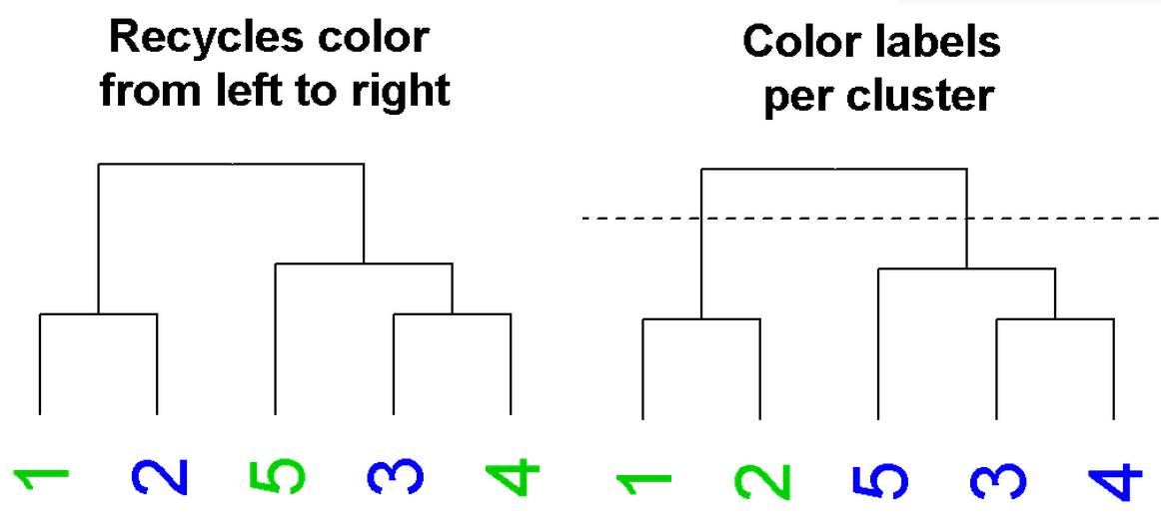

Slide 47
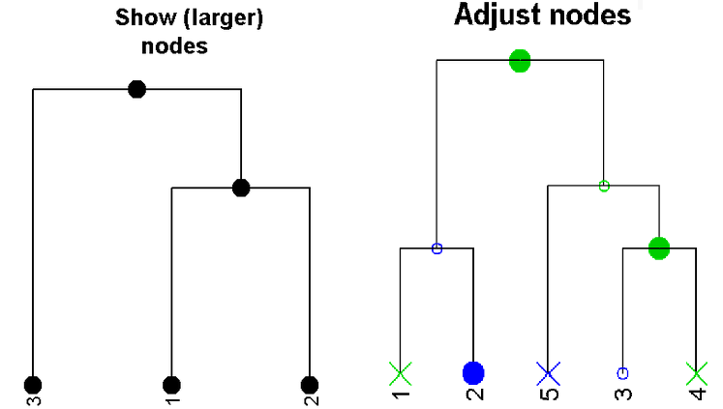
Modify nodes (no code)

Slide 48
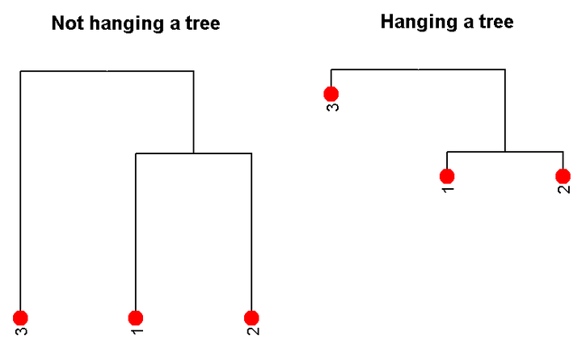
Modify nodes (no code)

Slide 49
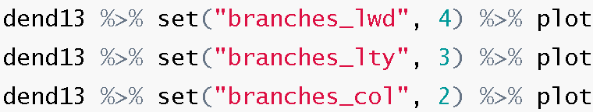
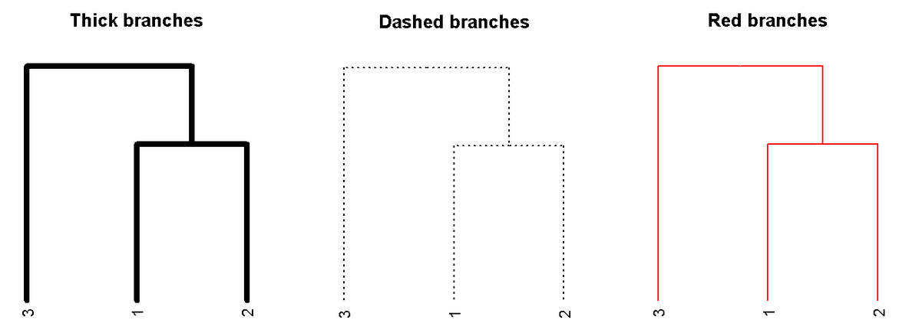
Modify branches

Slide 50
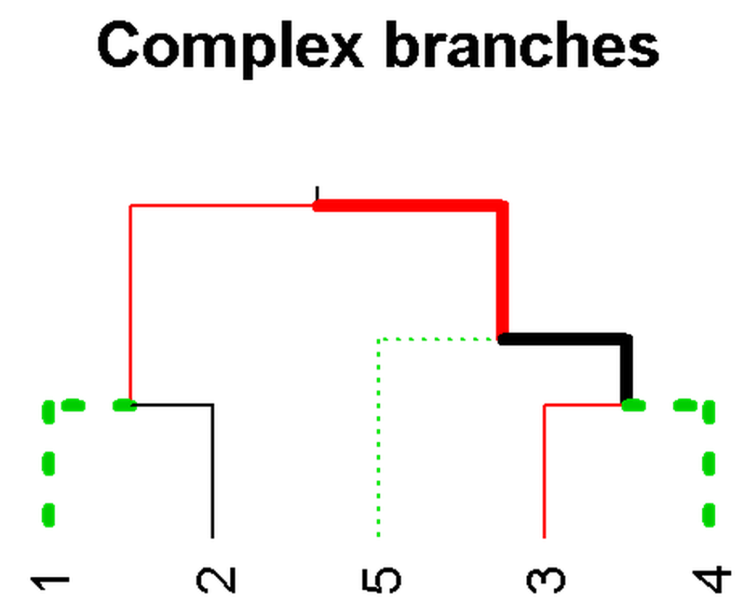
Modify branches

Slide 51
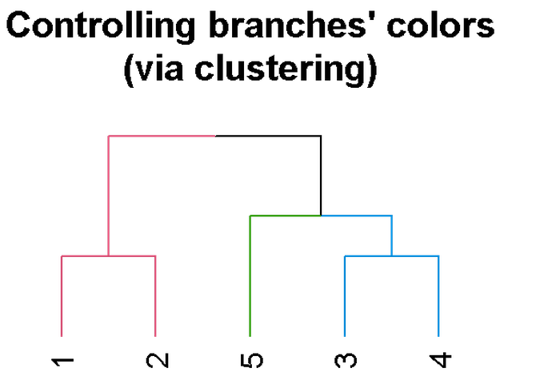

Slide 52
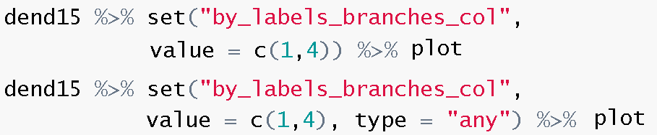
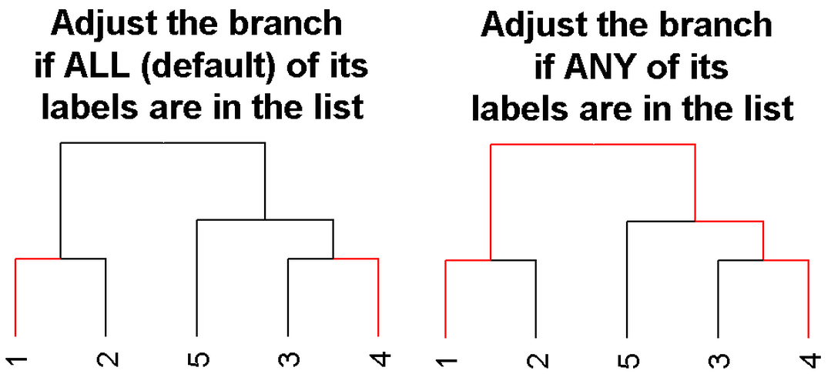

Slide 53
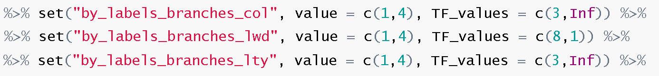
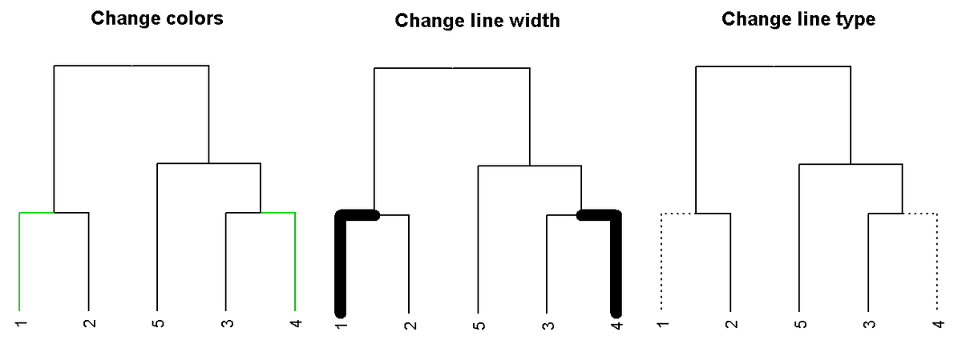

Slide 54
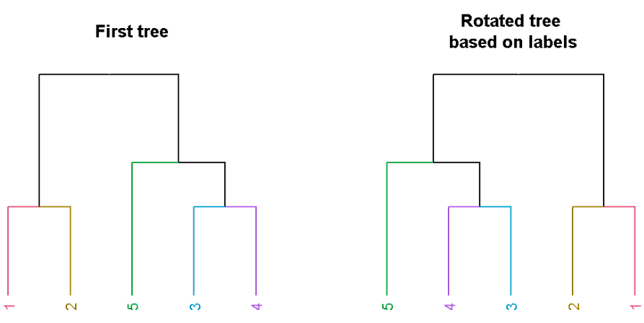
Rotate branches

Slide 55
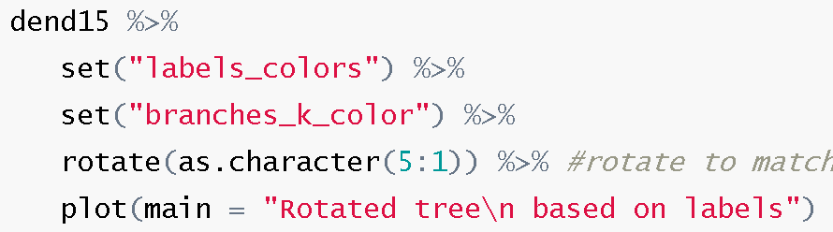
Rotate branches

Slide 56
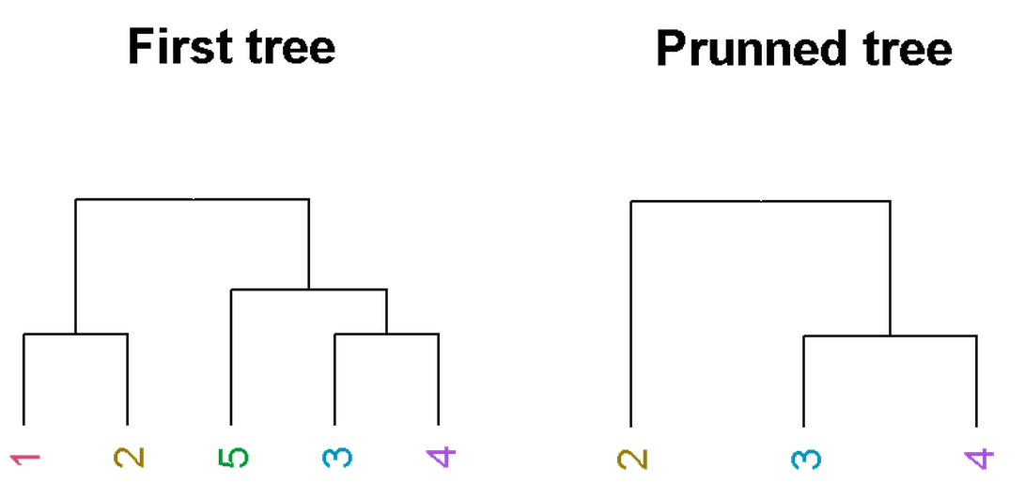
Prune branches

Slide 57
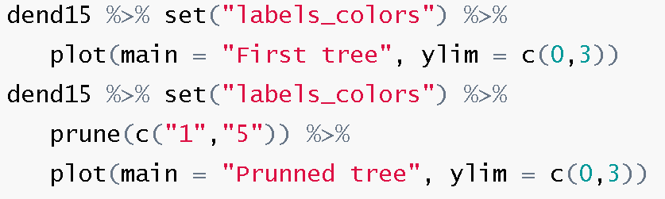
Prune branches

Slide 58

Add rectangles

Slide 59

Add rectangles

Slide 60
dendextend
and other packages

Slide 61

Gplots: heatmap.2

Slide 62

dynamicTreeCut

Slide 63

pvclust

Slide 64
Take-home messages:
hclust – is good for creating hierarchical clustering, but limited for plotting
dendrogram object
  a nested list of lists
  with attributes!
  should be modified step by step before plotting
Dendrograms can be compared
Use dendextendRcpp for (“free”) speed

Slide 65

Credits!
dendextend
This work was supported in part by the European Research Council under EC–EP7 European Research Council grant PSARPS-297519, and also by the HBP project.

Slide 66

Credits!

Slide 67
The dendextend package
Thank you!
for the slides:
R-statistics.com

Slide 68
Exploring a dendrogram

Slide 69



Slide 70

A dendrogram is a nested list of lists

Slide 71


Slide 72


Slide 73

Depth-
First
Search

Slide 74

Depth-
First
Search

Slide 75
Comparing dendrograms

Slide 76

tanglegram + untangle

Slide 77

tanglegram + untangle

Slide 78


“Correlation” measures

Slide 79

“Correlation” measures

Slide 80
dendextend
in the wild

Slide 81

Visually comparing two clustering methods

Slide 82

A plot from a recent HBP meeting in Lausanne
Dendrogram
Using all
variables
Dendrogram
Using 2
variables

Slide 83

Visually comparing two phylogenic trees

Slide 84
Send a dendrogram to d3heatmap
http://asbcllc.com/blog/2015/june/nba_14_15_top_50_heatmap/index.html

Slide 85
The dendextend package
Thank you!
for the slides:
R-statistics.com

