Slide 1
Random Forest in Distributed R
Arash Fard
Vishrut Gupta

Slide 2
Distributed R
Distributed R is a scalable high-performance platform for the R language that can leverage the resources of multiple machines
Easy to use:
library(distributedR)
distributedR_start()
Github page: https://github.com/vertica/DistributedR/
Coming Soon: CRAN installation

Slide 3
Distributed R
Standard Master – Worker framework
Distributed data structures:
darray – distributed array
dframe – distributed data frame
dlist – distributed list
Parallel execution:
foreach – function executed remotely Master is a normal R console
can run standard R packages

Slide 4
Random Forest in Distributed R
hpdRF_parallelForest
hpdRF_parallelTree
Great for small/medium sized data
Embarrassingly parallel
Each worker builds fraction of trees
Each worker needs the entire data
Calls random forest package
Very memory intensive
Doesn’t scale well
Great for large sized data: 1 GB +
Not Embarrassingly parallel
Doesn’t require all data to be on worker
Scales better than hpdRF_parallelForest
Smaller output model
Larger Distributed R overhead
Approximate Algorithm

Slide 5
hpdRF_parallelTree details
Distribute data across machines
Recursively on leaf nodes:
Compute local histograms
Combine global histograms and compute optimal split
Workers work together to find best split
Update tree with decision rule and create new leaf nodes
X7
1 2 3 4 5 6 7 8
Compute best split from histogram
X7 > 5
Scan feature 7
to create histogram
Build tree recursively

Slide 6
How to use Random Forest in Distributed R
Interface is extremely similar to randomForest function
Some additional arguments required
nBins – default value of 256
nExecutors – no default value (controls how much parallelism in hpdRF_parallelForest)
completeModel – default value set to false (decide whether to calculate OOB error)
Some output features not yet there
Variable Importance
Proximity matrix

Slide 7
MNIST dataset with 8.1M observations
library(distributedR)
library(HPdclassifier)
distributedR_start()
mnist_train <- read.csv("/mnt/mnist_train.csv",sep="\t")
mnist_test <- read.csv("/mnt/mnist_test.csv",sep="\t")
model <- hpdrandomForest(response~., mnist_train, ntree = 10)
predictions <- predict(model, mnist_test)
distributedR_shutdown()
Prediction accuracy of 99.7% with just 10 trees!
Not recommended to use read.csv (do this in parallel using Distributed R)

Slide 8
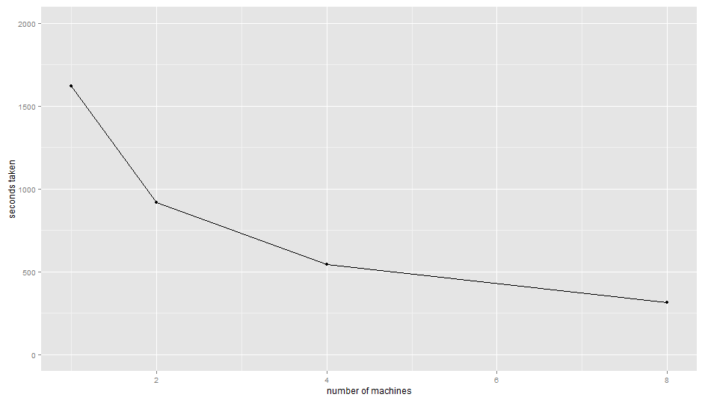
Scalability of hpdRF_parallelTree
Testing Conditions:
1M observations
100 features
12 cores per machine
R’s random forest takes about 106260 seconds (~29 hours) on larger machine

Slide 9
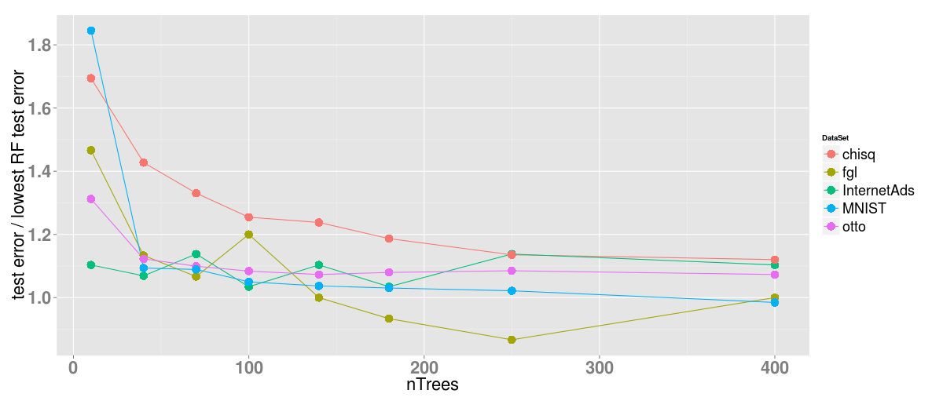
Accuracy of hpdRF_parallelTree

Slide 10
Conclusions
Distributed R
multi-core and distributed
Random Forest in Distributed R
Two parallel implementations optimized for different scenarios
Email: vishrut.gupta@hp.com

Slide 11
Appendix: Comparison with Other Implementations
Self reported results on MNIST 8.1M observations
wiseRF – 8 min
H20 – 19 min
Spark Sequoia Forest - 6 min
Spark MLLIB - crashed
Distributed R – 10 min
Distributed R is competitive
Disclaimer: These results were run on different machines

